Slide 1
Welcome to Penberth class

Slide 2
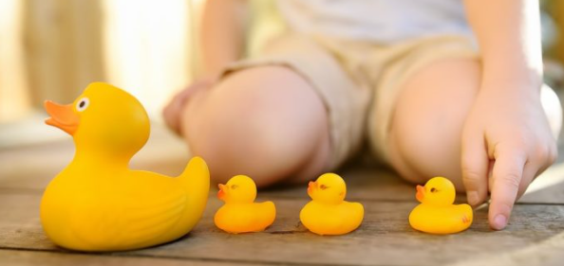
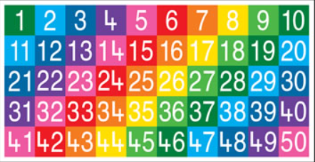
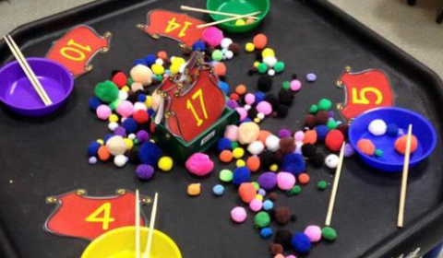
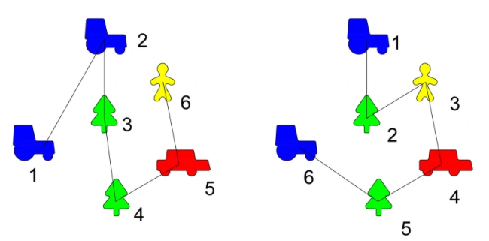
Maths Principles When teaching maths we ensure that children are very secure in these 5 principals:
1. One to one correspondence
2. The stable order principle
3. The cardinal principle
4. The abstraction principle
5. The order-irrelevance principle

Slide 3
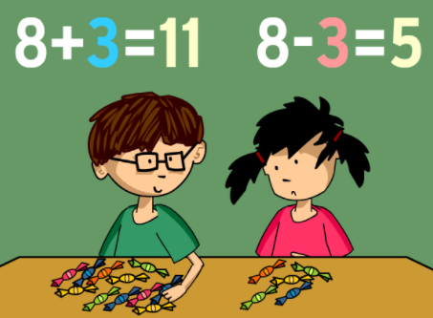

Slide 4
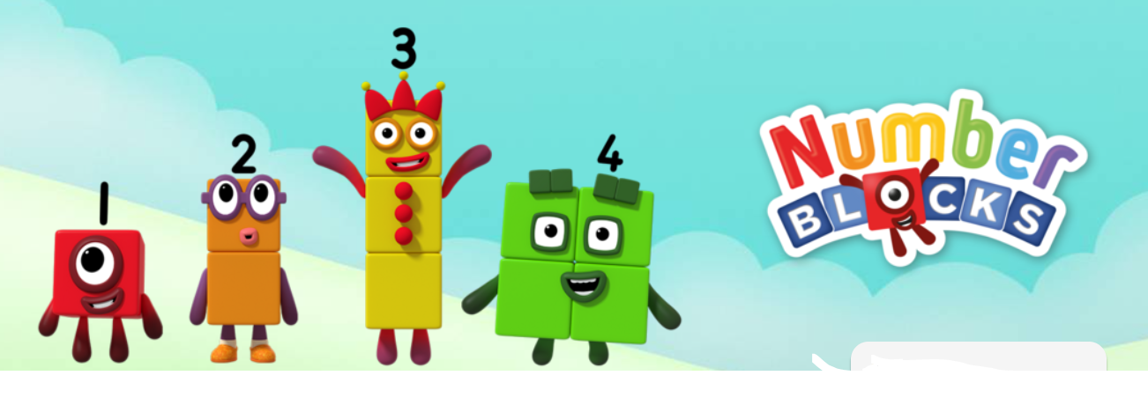
Numberblocks - CBeebies – BBC
https://www.bbc.co.uk/cbeebies/shows/numberblocks

Slide 5
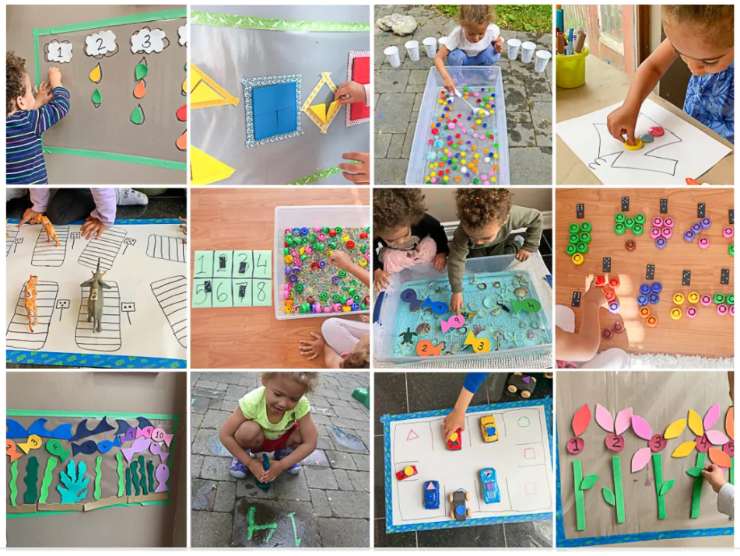
Maths is everywhere around us.
Some ideas for maths at home:
Counting steps
Cooking, baking
Scales- balancing and measuring
Patterns (repeating, symmetrical)
Hopscotch and similar games
Singing nursery rhymes
Measuring height, length, width
Clocks- analogue and digital
Origami folding
Building with blocks
Keep it fun, positive and don’t be afraid to make mistakes (and learn from them).

Slide 6
Phonics We teach reading and writing using systematic synthetic phonics.
First, we teach the graphemes (letter shapes) and corresponding phonemes (sounds).
To read words, children pronounce the individual phonemes (sounds) associated with the graphemes (letters). Then they blend them together (synthesise) to form the word.
To write words we need to segment the sounds in a word and note each grapheme at the time.
Graphemes – letter shapes
Phonemes- sounds
Blending- to read
Segmenting- to write

Slide 7
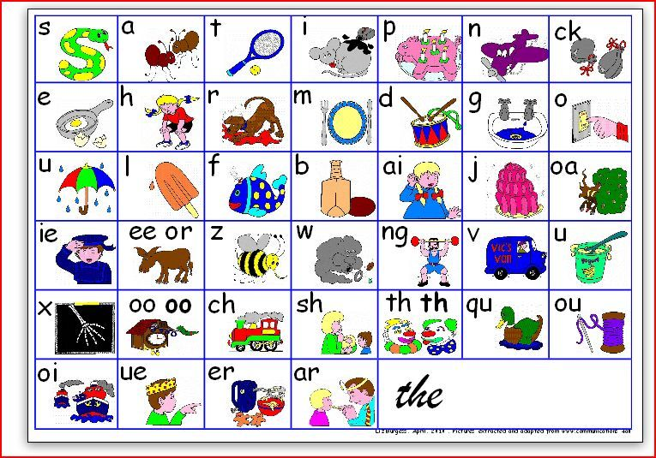
We are learning Phonics
in a multi-sensory way:
Using flashcards
Singing songs
Remembering pictures/story
Writing in the air, on whiteboards, sand, foam/water, painting, etc.
https://www.youtube.com/watch?v=hIQ5L9xgU4g

Slide 8
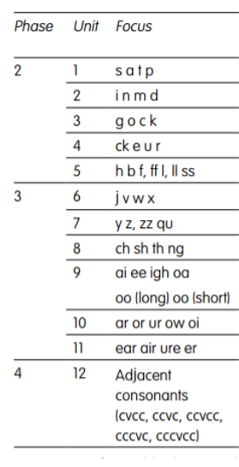
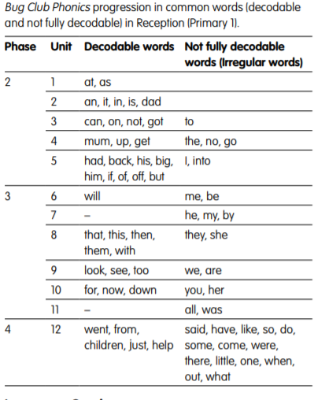

Slide 9
https://www.activelearnprimary.co.uk/resources#bugclub_phonics

Slide 11
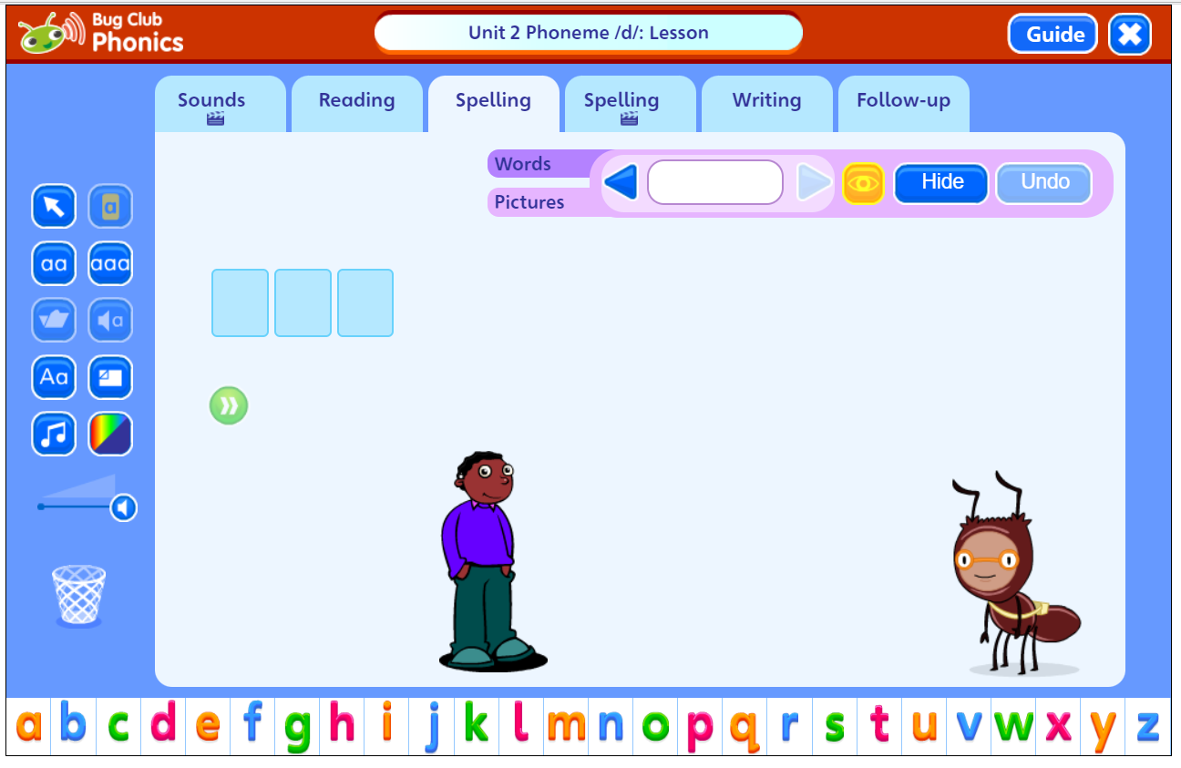

Slide 12
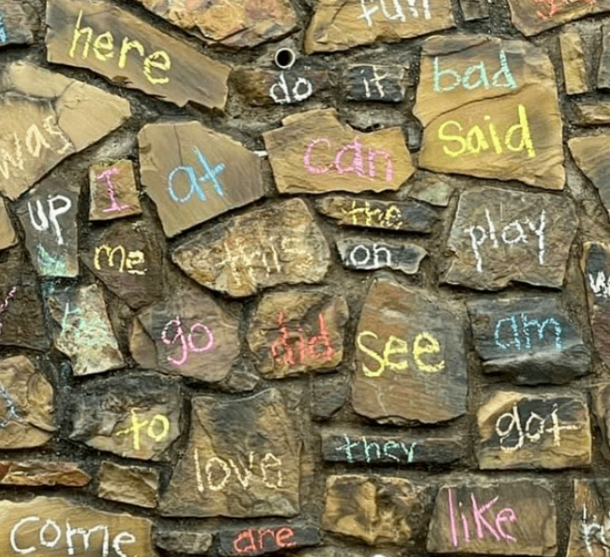
You can help by:
Reading at home every day
Going through the sound cards
Encouraging writing on worksheets to practise letter shapes
Encourage writing in different ways in play or everyday situations e.g. name writing, labels, shopping lists, cards/ letters etc.
Display sounds and sight words around the house
Play games e.g. I spy with my little eye…
Use blending and segmenting in everyday situations e.g. “bring me your h-a-t”
Puzzles

Slide 13
Books
Reading Books
Some books we send home will be phonically decodable, based on the sounds the children have learnt so far.
Others will have a focus on high frequency words, these are not decodable, your children will need to practise reading these with you first. These words will be reinforced on the keyring words we send home.

Slide 14
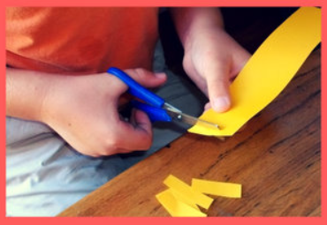
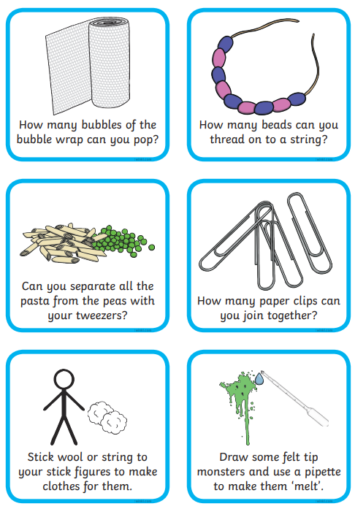
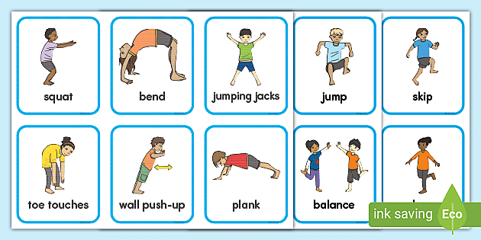
Gross motor skills
and
Fine motor skills
are essential for good development

Slide 15
Please email us or talk to us at the gate whenever you feel you would like to communicate anything. Check website for current photos and news. Any questions? Thank you ☺

